Slide 1
Protein Language Models
Dinner ML Journal Club 6/20/2024
Darren Liu
Notes:
ddddd

Slide 2
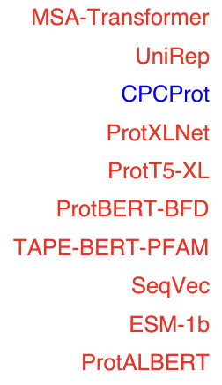
There are many examples of language models applied to protein sequence data
Language models trained on large text databases can understand the grammatical and syntax rules of human language
Proteins sequences are complex, with long range and higher-order interactions that are hard to model
We could apply the NLP architecture to proteins and learn the rules and contexts in which particular amino acids appear
Protein Language Models (pLMs)
Notes:
Protein sequences are made of amino acids, or words

Slide 3
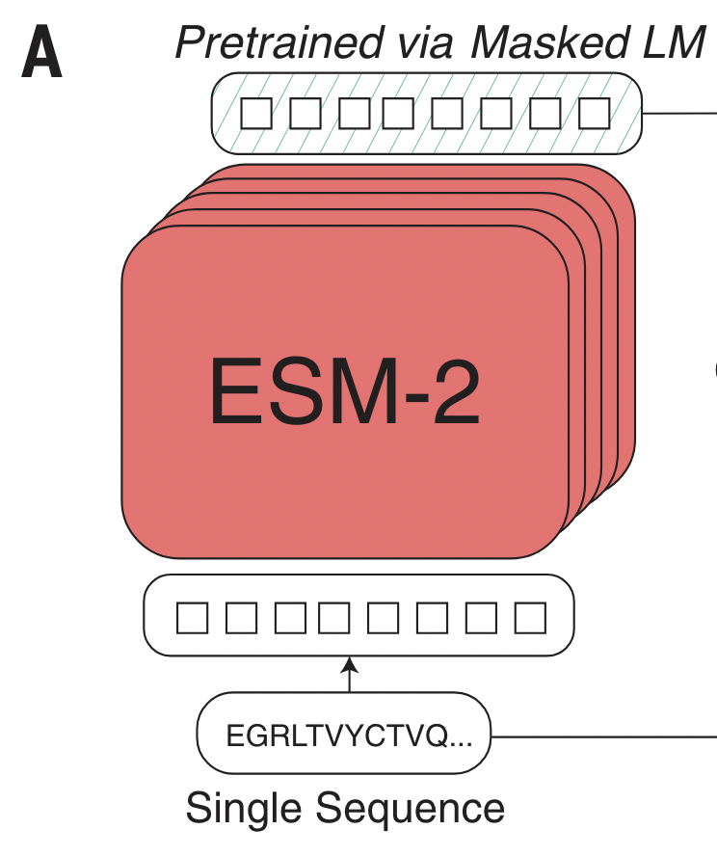
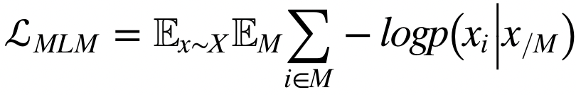
What is ESM?
Evolutionary Scale Modeling
Encoder only BERT language model
Masked language training objective
Input → Protein sequence
Output → Distribution of amino acids given a sequence background
Trained over nearly 65M protein sequences
Probability of amino acid at position i given sequence context
Expectation over sequence x averaging all possible masking indices M
Notes:
Meta’s protein language model
It takes in a protein sequence and outputs the probability distribution of amino acids for a given position
Purely sequence, no information about structure or function or evolutionary history
Is trained on UniRep, so representative sequences

Slide 4
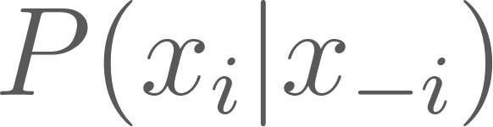
ESM2 training
E ~ 5120
‘Embeddings’
Mask
48 Self-attention Heads
MLP + row softmax
L
L
1
E
One hot + RoPE positional encoding
L
Predict the masked amino acid
A
Notes:
During training, one of the positions is covered by a special ‘mask’ token
Simply just a reconstruction task, no notion of protein family or fitness labels or structure. Self-supervised
Training over natural protein sequences helps to build evolutionary information into the model itself.

Slide 5
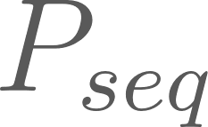
ESM2 inference
48 Self-attention Heads
MLP + softmax
L
L
L
1
E
A
Embeddings are a ‘good’ representation of a protein sequence
One hot + RoPE positional encoding
Notes:
Mentioned that the embeddings are useful
If you wanted to get the likelihood of a sequence, you would just pick numbers from this matrix
Go back to talk about the loss

Slide 6
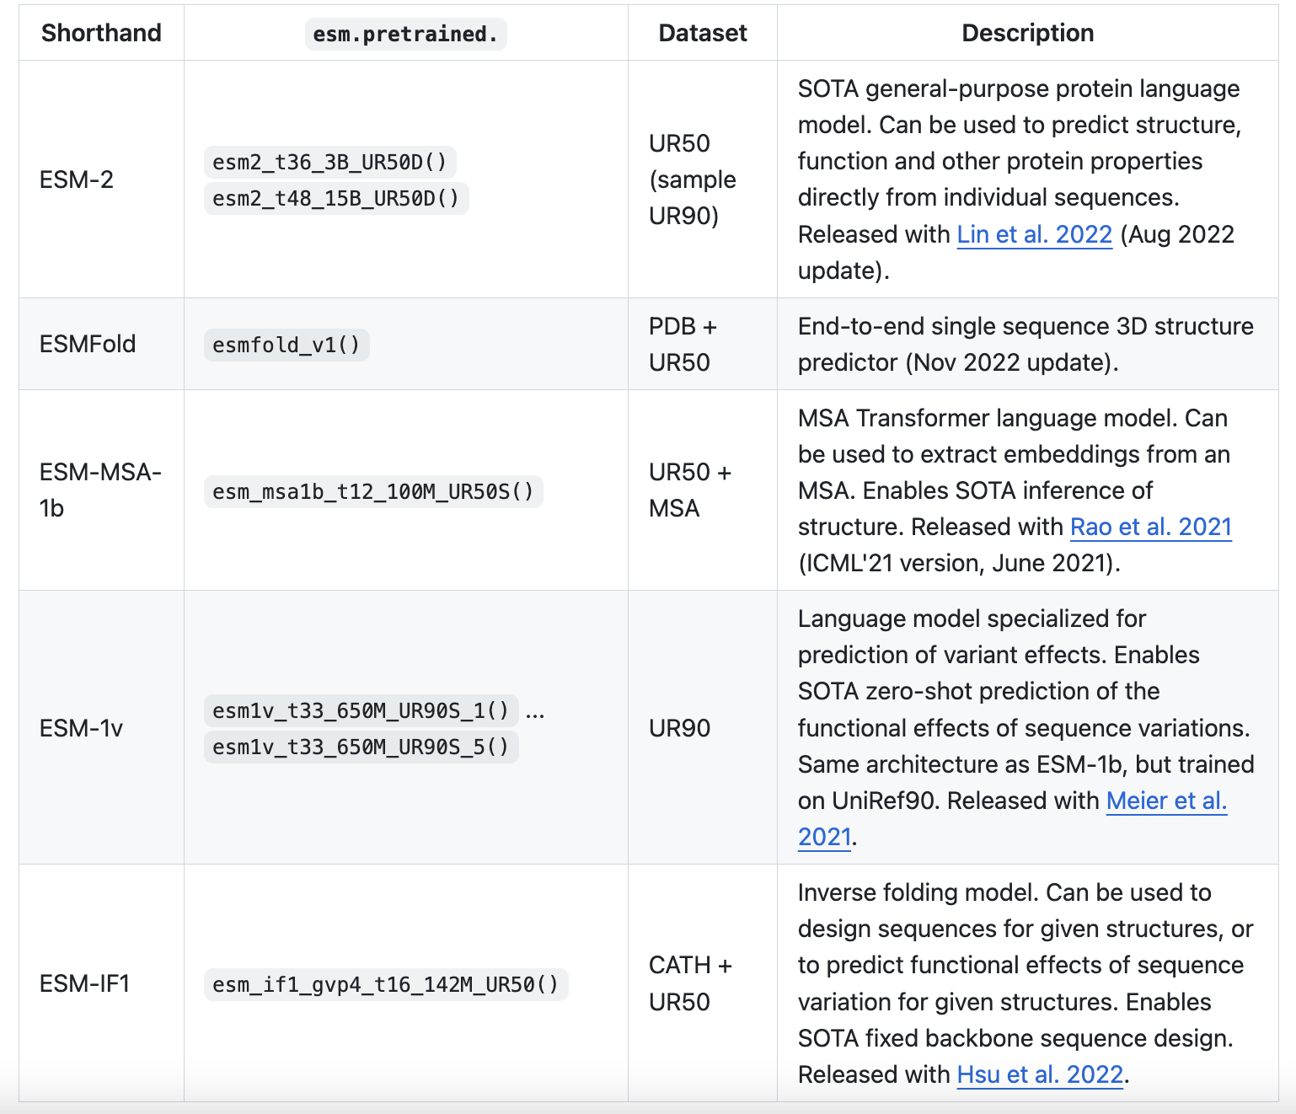
What do people use ESM for?
There are many different types of ESM models for different needs
Structure prediction
Sequence to function mapping
Modeling evolution
Notes:
The model itself is not that useful, but the outputs

Slide 7
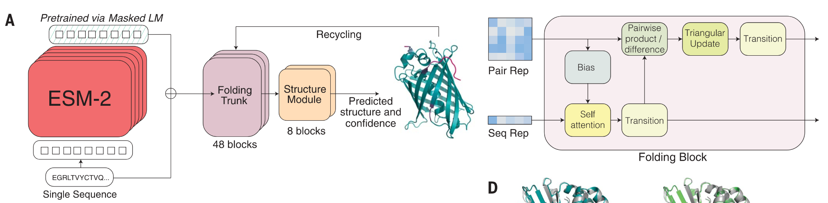
ESMFold allows for MSA-free structure prediction
Architecture is almost the same as AF2
48 folding blocks, 8 structure models, 3 recycles
Input → Sequence
Output → Structure and error metrics (pLDDT, pAE)
Notes:
https://www.science.org/doi/10.1126/science.ade2574
In af2, you would input a sequence, it would generate an MSA + pair rep and that would go through a series of folding trunks and structure modules
In ESM, you input a sequence, it would output smth called an ‘sequence representation’ that along with the pair representation

Slide 8
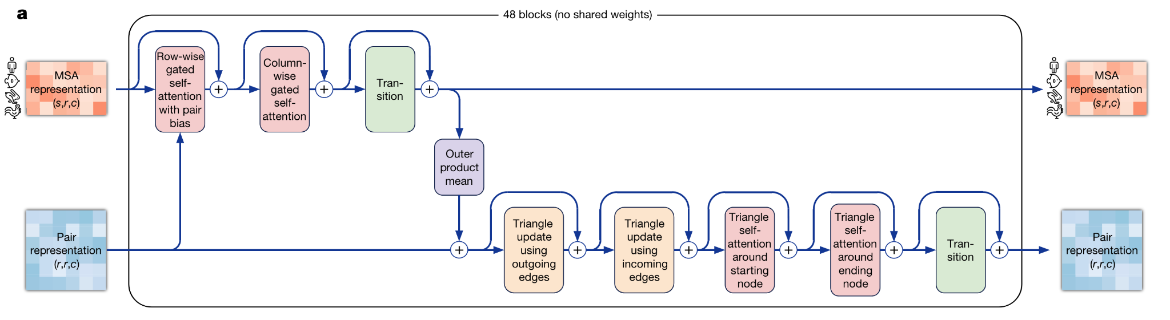
"Hey can I copy your homework?" yeah but change it a bit so it's not obvious
L
MLP
E
Notes:
Pairwise representation is the same as AF2
MSA representation is replaced with parameterized sum of ESM embeddings to generate a one dimensional sequence representation
In AF2, the MSA is two dimensional, so there is both row wise and column wise self attention. Since the sequence rep is one dimensional, we only need self attention. The rest is the same

Slide 9
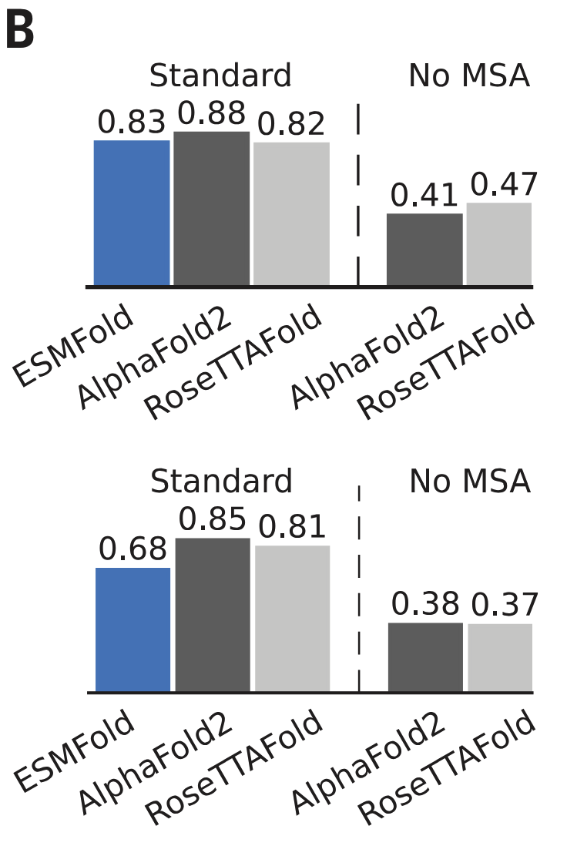
Why would you ever use this?
Allows for structure prediction without the need for an MSA
Up to 60x faster with default AF2 MSA generation, albeit with less accuracy
If you want to run inference on many many sequences, the speed up could be useful
Structure prediction for proteins that do not have strong MSAs
Many designed proteins generated from deep learning models have very low sequence similarity to natural sequences
For most applications, using alphafold2 will be your best bet
CAMEO
CASP14
Notes:
No real reason tbh
There are two main niche cases
Orphan proteins do exist
Most of the speedup for ESMFold is dependent on default AF2 MSA generation. Many different implements of alphafold make this much faster (i.e. CollabFold) at the cost of decreased MSA sensitivity.

Slide 10
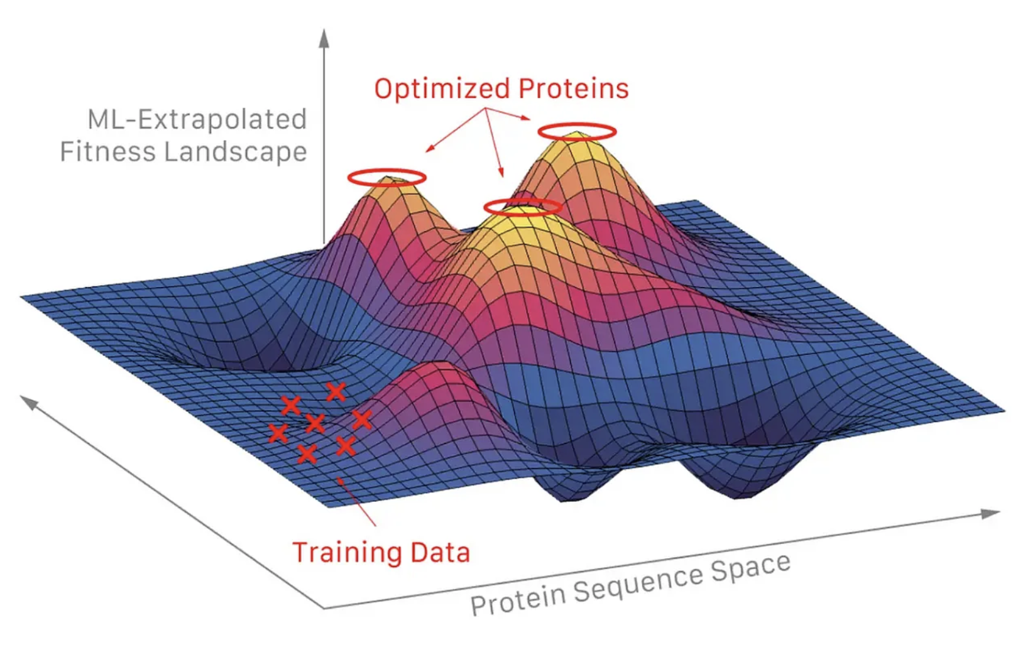
Sequence to function maps can help guide protein engineering
Sequence to function maps are important
We would like to design proteins with a new desired function or enhanced activity
Experimentally, we are quite limited in the number of sequences we can generate and assay
Model-guided optimizations can help make protein engineering more efficient, but tend to need some sort of sequence to function mapping
Notes:
https://medium.com/@axialxyz/machine-learning-guided-mutagenesis-fd661babd38d
This is such an exaggeration. The training data is probably in one of the main peaks lol
You can imagine two types of models. Traditional models are supervised, benchmarked against DMS data

Slide 11


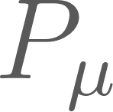
Differences in sequence likelihoods can be used as a functional readout
Model
WT
Make mutation
Model
Correlates with experimental fitness measurements of mutant (relative to WT)
Notes:
You can do this for any model that assigns a probability to a sequence, we saw that we could do this with pLMs

Slide 12

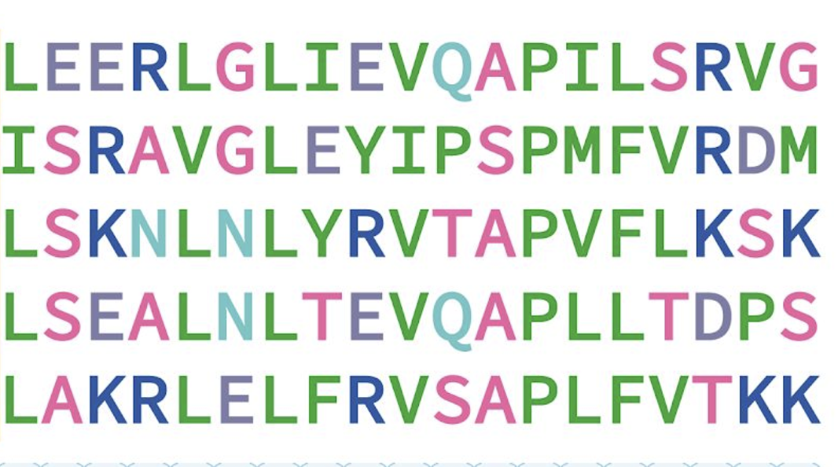
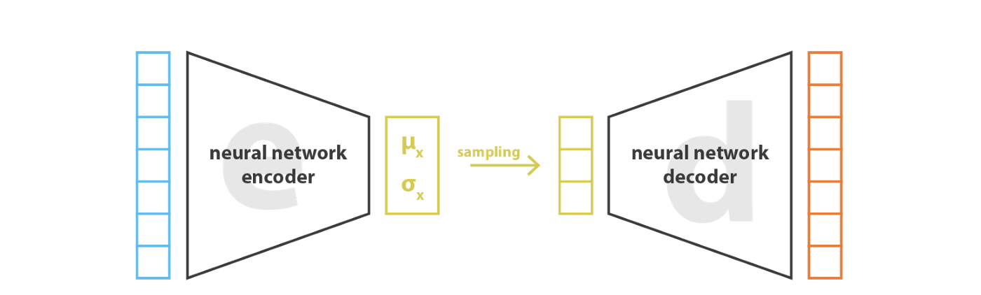
One can build ‘supervised’ or ‘unsupervised’ models to assign probabilities to sequences
‘Supervised’ (VAE Model)
Collect an MSA of naturally occurring homologous proteins
Train a VAE on the MSA
Assign probabilities based on VAE likelihoods
All MSA sequences are assumed to be functional
‘Unsupervised’ (ESM)
Collect data on a large number of unrelated protein sequences
Train a pLM on these datasets
Assign probabilities based on energetics of ESM
No explicit information about function
Notes:
https://www.biorxiv.org/content/10.1101/2020.11.27.401232v1.full
pLMs are not the only ways to assign probabilities to sequences!
These are both technically self-supervised models, but supervised/unsupervised in the sense of what sort of data they are trained on
The supervised approach is much more intuitive approach. Why would you want to train on all of these sequences that don’t seemingly matter and don’t have any sort of function

Slide 13
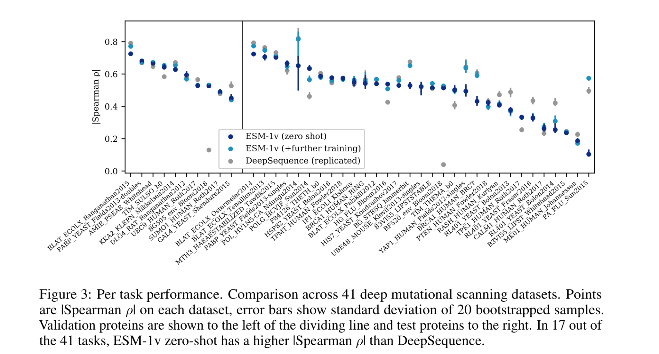
ESM can perform similarly to supervised models with little to no training
Notes:
https://www.biorxiv.org/lookup/doi/10.1101/2021.07.09.450648
Even though there is no information about fitness during training, this difference in likelihood procedure has shown to correlate strongly across different notions of fitness
Each column is a different DMS dataset where people have experimentally generated mutations (generally single) around a particular protein and experimentally measured fitness.
This graph shows how ESM likelihoods are correlated with experimental fitness across a variety of different proteins
Big takeaways is that the blue is close to the gray (a modeled trained on a particular protein family). DeepSequence is a Potts model trained on an MSA
Ensembled ESM, different ESM model than Listgarten, different fine-tuning strategy

Slide 14
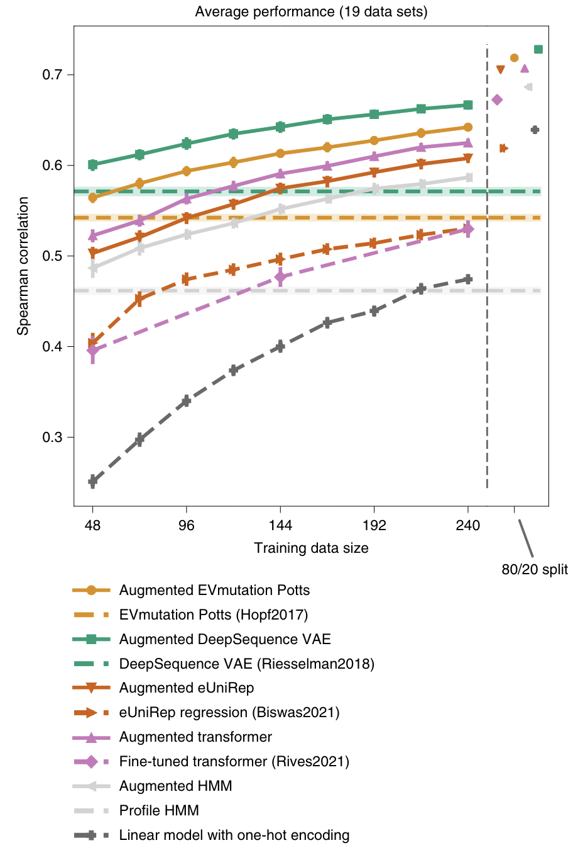
Why would you ever want to use this?
My opinion is that supervised models trained on ‘focused’ training data or models that more explicitly model sequence to function maps will perform better than pLMs
pLMs are very easy to use and will mostly get you there if you don’t already have good data or sophisticated model
Embeddings can be a better representation of a protein sequence as opposed to simply one-hot encodings
Notes:
https://www.nature.com/articles/s41587-021-01146-5
What is ‘fitness’ for pLMs. By training over all unlabeled protein sequences, it cannot learn any sort of activity. It is probably just learning protein stability
What is ‘focused’ training data? DMS measurements on single and double mutants
Epistasis is not here

Slide 15
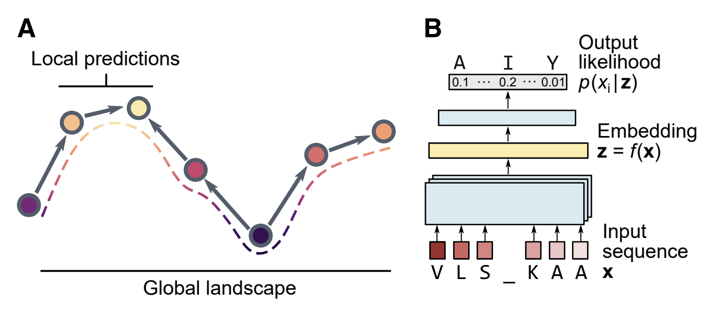
Global evolution can be modeled by local changes in fitness
Proteins evolve over time to climb a fitness landscape
Hard to track individual dynamics
Sequences are sampled from a bulk population
Can we learn dynamics?
A model trained on many protein sequences should learn evolutionary trends
Notes:
https://www.sciencedirect.com/science/article/pii/S2405471222000382?via%3Dihub
For influenza for instance, it’s hard to follow a single virus evolving over time. Most of the time, what happens is that sequences of the virus is sampled from the population. Effectively snapshots
Dynamics → Which mutations were picked up at which times
A model trained on (most) protein sequences should learn evolutionary trends

Slide 16
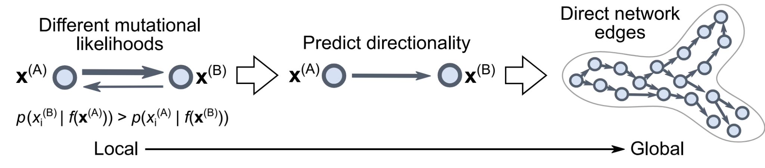
Sequence likelihoods can be used to model evolution
Collect sequences of naturally occurring proteins, sampled over time
Build graph of protein sequences
Edge direction and weight are assigned based on sequence likelihoods assigned by ESM-1b
Can calculate 3 main quantities:
‘Evo-velocity’ → Difference in sequence likelihood, can build transition matrix
Roots → Model a reverse diffusion process on the network, can infer ‘roots’
Pseudotime → Learn the order of sequences given a root
Notes:
Build a graph where each node is connected to 50 NN
N_neighbors = 50
Difference in sequence likelihood can be seen as a transition probability
Can build pseudo evo-velocity vector fields
Build a transition matrix and can simulate dynamics

Slide 17
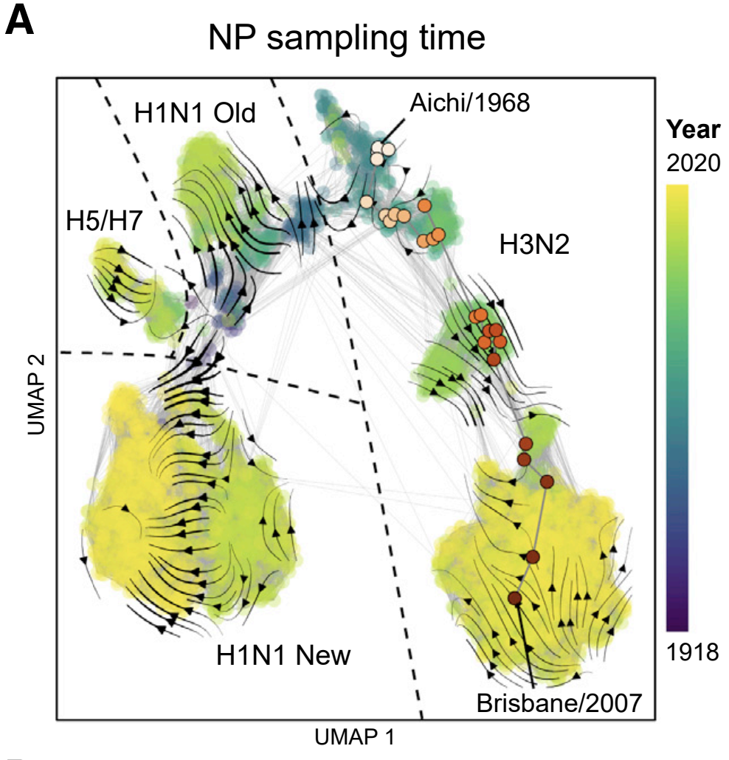
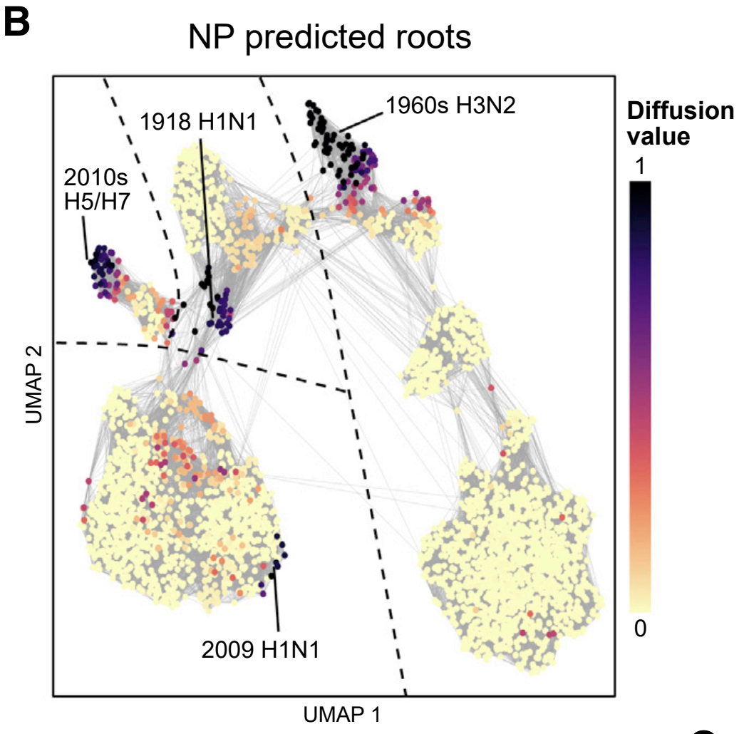
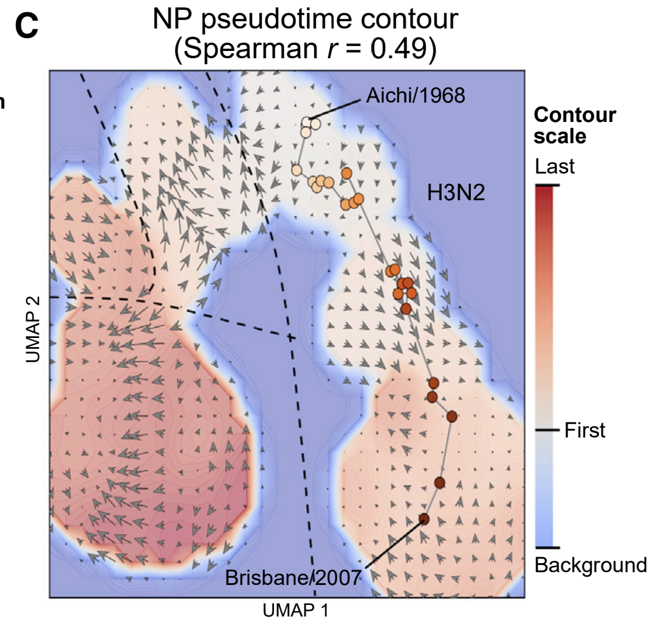
ESM can reproduce broad strokes of evolution
Notes:
nucleoprotein (NP) of influenza A virus
Sample ~3K NP sequences from influenza A sampled from human hosts
Roots correspond to “main species cross over events”, showing that the reverse diffusion process was able to correctly identify evolutionary roots. Different sections are different strains
Psuedo time is roughly correlated with actual sampling time
Model has no data about the sampling time or roots
Some actual takeaways/new insights from this model
If you build a phylogenetic tree, it suggestions that H5/H7 stemmed off of H1N1
Evo-velocity suggests that they are independent events, which apparently matches experimental evidence
H5/H7 and H1N1 have similar sequences due to convergent evolution
The top 5 mutations associated with the largest change in sequence likelihood involve a Met going to a hydrophobic/polar uncharged residue, indicating a mechanism for T-cell escape
Could use this to model and predict viral evolution

Slide 18
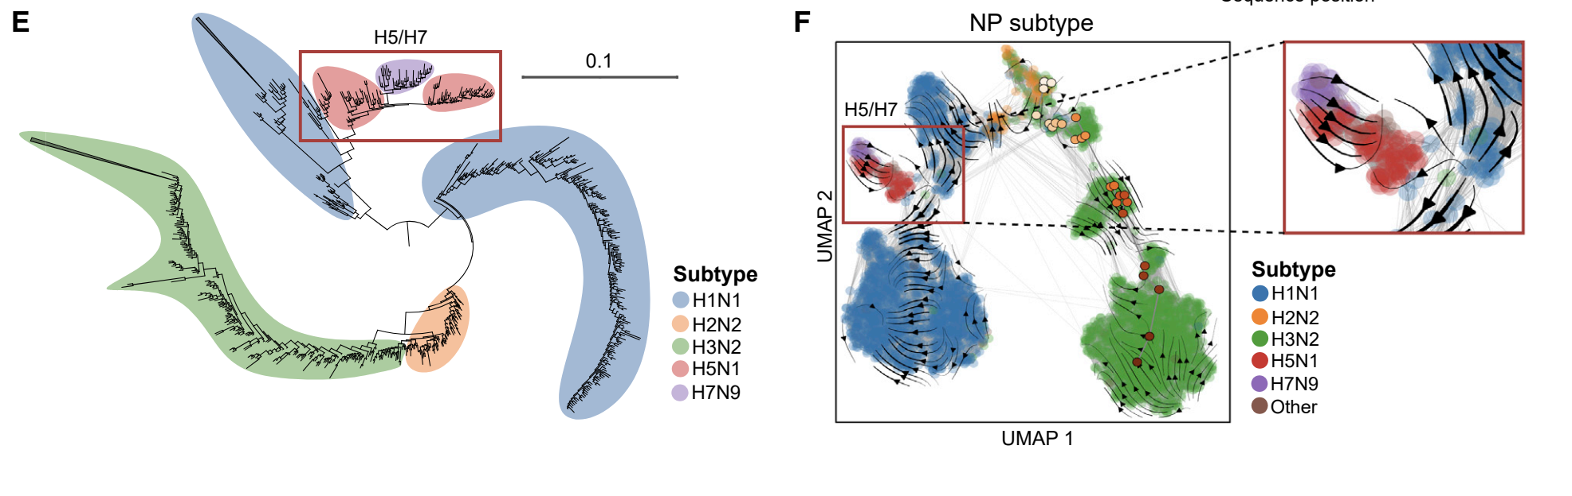

Slide 19
Conclusions
pLMs are self-supervised models trained on large sequence databases
Can be used for a variety of applications
Structure prediction
Sequence to fitness mapping
Evolutionary modeling
pLMs are generally not the best solution to any given problem, but decent enough and easy to use for general purposes

Slide 20
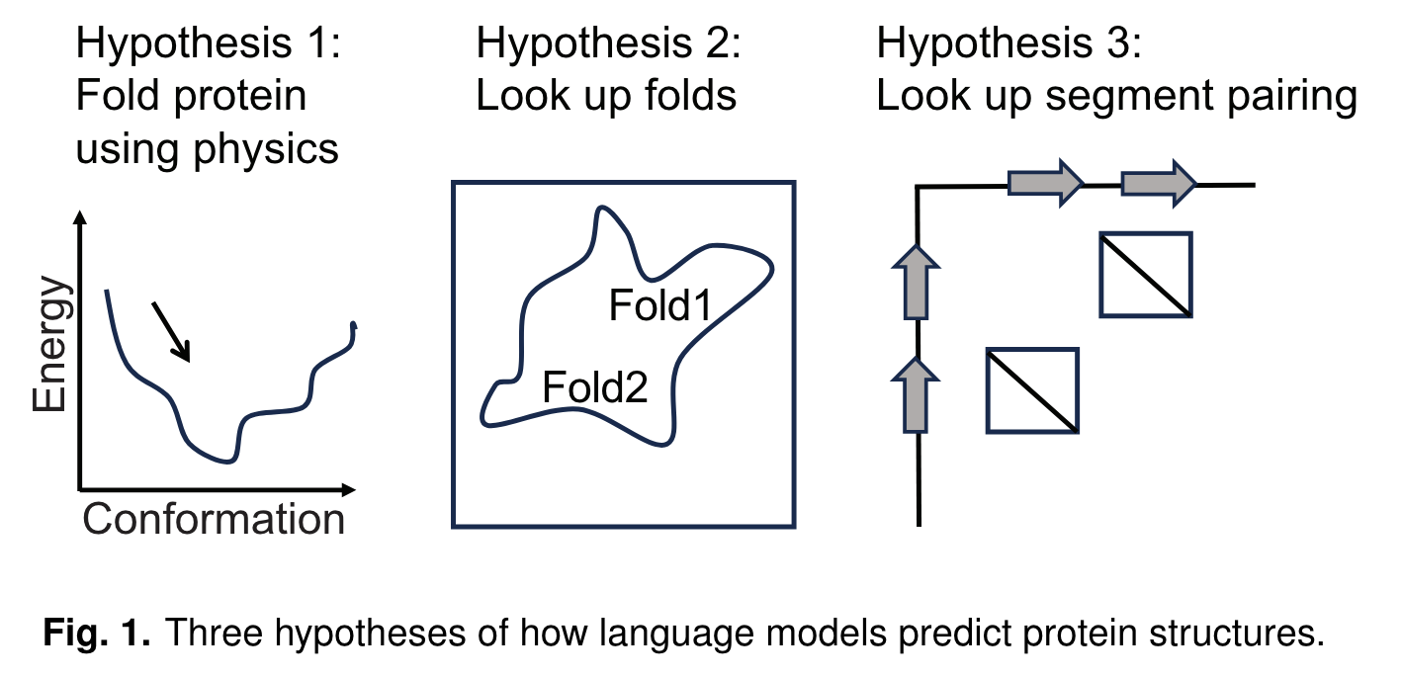
Are pLMs black boxes? What are these things actually learning?

Slide 21
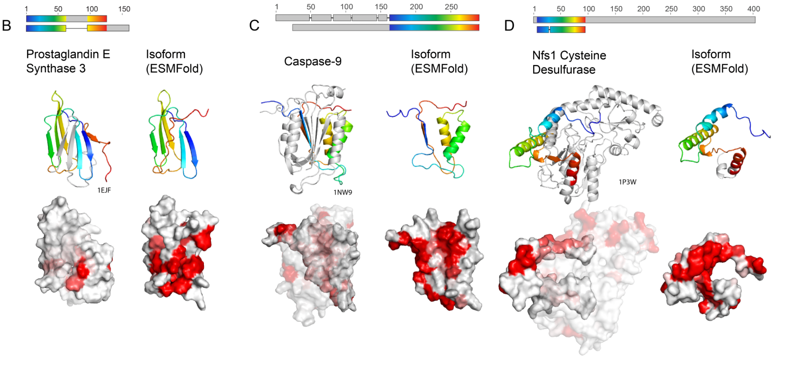
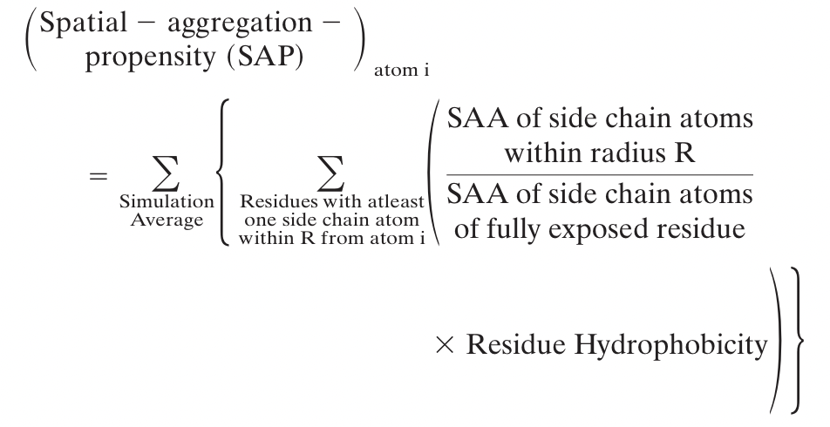
ESM has not learned the physics of protein folding
Notes:
-SAP is SASA, but it takes into account the hydrophobicity of the residue. If we want to find hydrophobic patches, we need this! Higher is more hydrophobic
- Isoforms are proteins that have came from alternative splicing events where domains have been excised out(?). Have thought to be nonfunctional/not structured due to measures of stuff like hydrophobicity (?). Full length protein is in transparent grey
- I think the procedure is to throw the isoform sequence into alphafold, but align to full length structure
- Tend to be problematic for protein structure prediction, very similar sequence but can have different structures in different contexts. If these models learned physics, then they would predict alternative structures or not folded
- pLDDT is high so it is confident in what it is doing
- There are large patches of high (red) SAP, which would indicate exposed hydrophobic residues which is unlikely biophysically. ESM also just predicts the full length structure (low RMSD to full length) and not something else. We do not have experimental evidence of the in vitro structure of just the isoforms
- ESM does not have an model of protein folding
https://www.pnas.org/doi/10.1073/pnas.0904191106

Slide 22
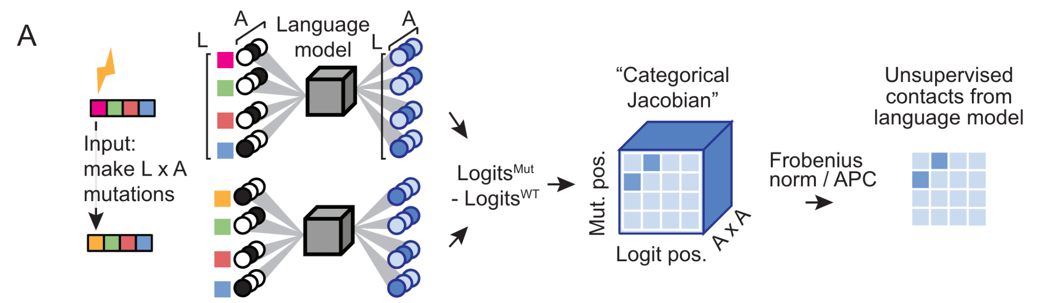
A quick aside about unsupervised contact prediction
Notes:
People can identify contacts from pairwise couplings
Here we can calculate contact maps WITHOUT the supervised folding head

Slide 23
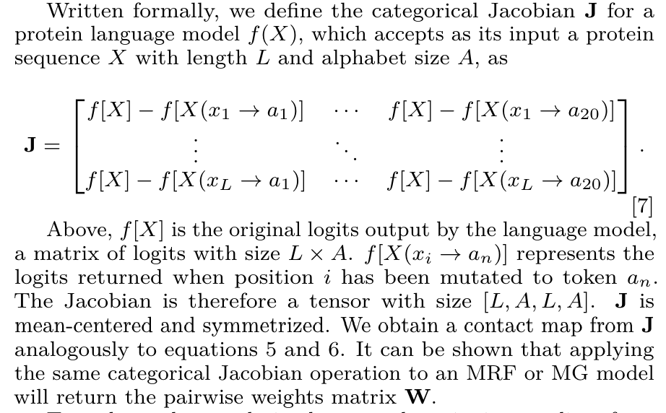
A quick aside about unsupervised contact prediction

Slide 24
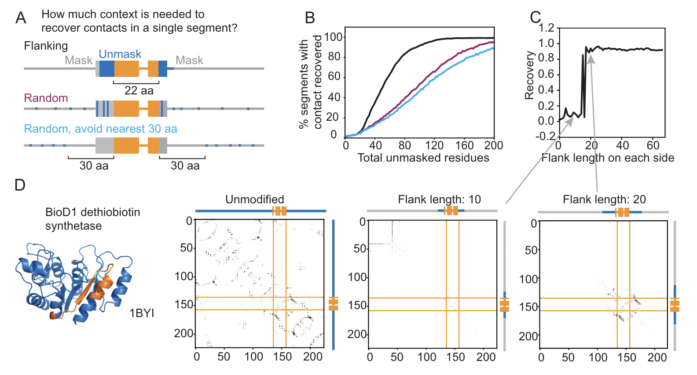
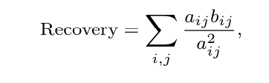
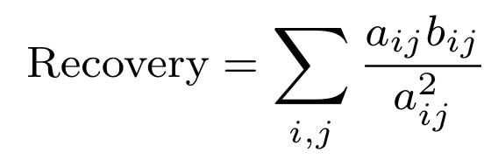
ESM is not memorizing protein folds, it is identifying interacting pairs of sequence motifs
Notes:
You can ask mask most of protein, except for a particular segment and then calculate contact maps
The way I see things. Get logits for each mutation and compare logits of those sequences to logit of original masked sequence
Unmask segments in a particular way
Random, with flanking regions, or random and ignore the closest 30 aa
C is recovery of a single segment, step like behavior at 20 residues
Recovery is
Step-like
Removing flanking sequences recovers contacts the best

Slide 25
Is this the best we can do? Are we doomed (limited by number of parameters, number of layers, and pure compute power)?

Slide 26
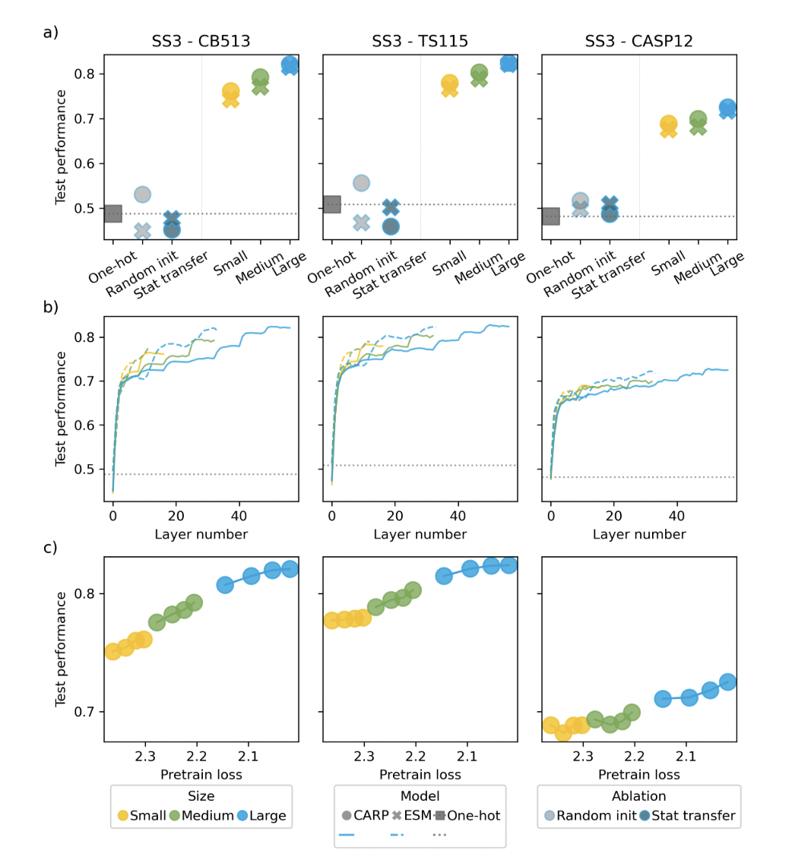
This is probably true for structure prediction
Notes:
Solid line CARP, dashed line ESM
Colors are model sizes

Slide 27
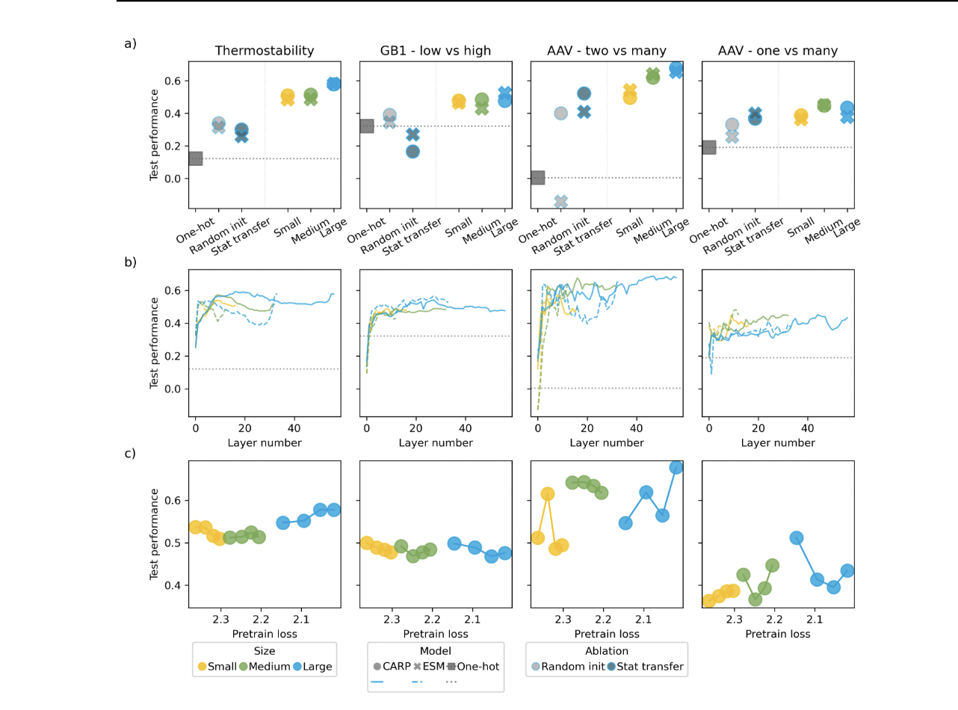
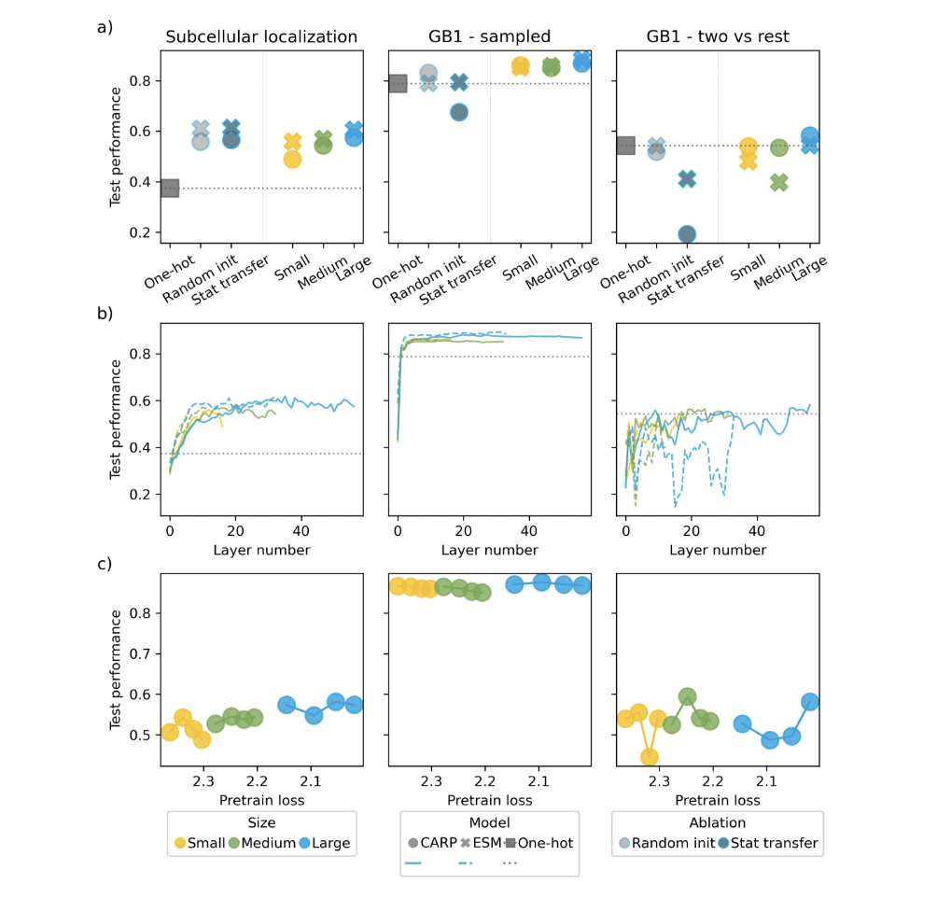
Transfer learning helps for some tasks, but performance seems to have leveled out with scaling
Notes:
One hot is one hot
Random init is pLM with random weights
Stat transfer is random weights with the same distribution as trained models
Low vs high → Train on low fitness, predict on high
Two vs many → Trained on single + double mutants, predict on more
One vs many → Trained on single, predict on more

